Slide 1
Agentic AI for Personalized Course Pathways (learnmate)
CAPSTONE PROJECT
Presented By:
1. Shubhanshu Kumar- Rungta College of Engineering and Technology, Bhilai(C.G)

Slide 2
Contents
Problem Statement
Proposed System/Solution
System Development Approach
Algorithm & Deployment
Result
Conclusion
Future Scope
References

Slide 3
Problem Statement
Students often struggle to identify the right learning path that aligns with their interests and long-term goals due to the overwhelming number of online courses and a lack of personalized guidance. LearnMate aims to solve this by acting as an Agentic AI coach that interacts with students, understands their interests (like Frontend Development, Cybersecurity, UI/UX Design, etc.), assesses their current skill level, and dynamically builds a personalized course roadmap that adapts over time based on progress and preferences.

Slide 4
Proposed Solution
LearnMate leverages Agentic AI to deliver personalized learning pathways through:
Interest Mapping: Understands students’ interests (e.g., Frontend, Cybersecurity, UI/UX).
Skill Assessment: Evaluates current knowledge through intelligent questioning.
Adaptive Roadmaps: Dynamically builds and updates course plans based on progress, goals, and feedback.
Ongoing Guidance: Acts as a 24/7 mentor—offering curated resources, motivation, and real-time direction.
Outcome: Reduced overwhelm, increased clarity, and better alignment with long-term career goals.

Slide 5
System Approach
System Requirements for LearnMate AI (IBM Cloud)
Model & Framework
Model: llama-3-3-70b-instruct
Framework: LangGraph
Architecture: ReAct
Required Libraries for LearnMate
Purpose | Libraries
LLM Interface | transformers, llama-cpp-python, openllm
Agent Framework | langgraph, react-agent, langchain
UI & Skill Assessment | streamlit, custom Python logic

Slide 6
Algorithm & Deployment
Algorithm Selection
We use a hybrid Agentic AI approach combining LLM (e.g., LLaMA 3) with ReAct architecture and LangGraph framework. This design enables reasoning, tool use, and dynamic interaction — ideal for adaptive learning path generation based on user inputs and progress.
Data Input
Key inputs include:
Student interests (e.g., Frontend Dev, Cybersecurity, UI/UX)
Current skill level (via quizzes or self-reporting)
Learning goals and timeline
User progress (course completions, quiz results)
Feedback and preferences
Training Process
We use pre-trained LLMs (e.g., LLaMA 3) hosted on IBM Watsonx.
No task-specific training required, but behavior is customized through prompt engineering and LangGraph-based flow design.
Fine-tuned models or embeddings (if used for resource matching) are optimized with semantic search and user feedback.
Prediction Process
The AI dynamically generates a personalized course roadmap based on interests, goals, and real-time user feedback.
Recommendations adapt over time by tracking learning progress and adjusting paths using context memory (e.g., via vector stores).
External tools (search engines, Wikipedia, web crawlers) assist in fetching up-to-date resources for each learner.

Slide 7
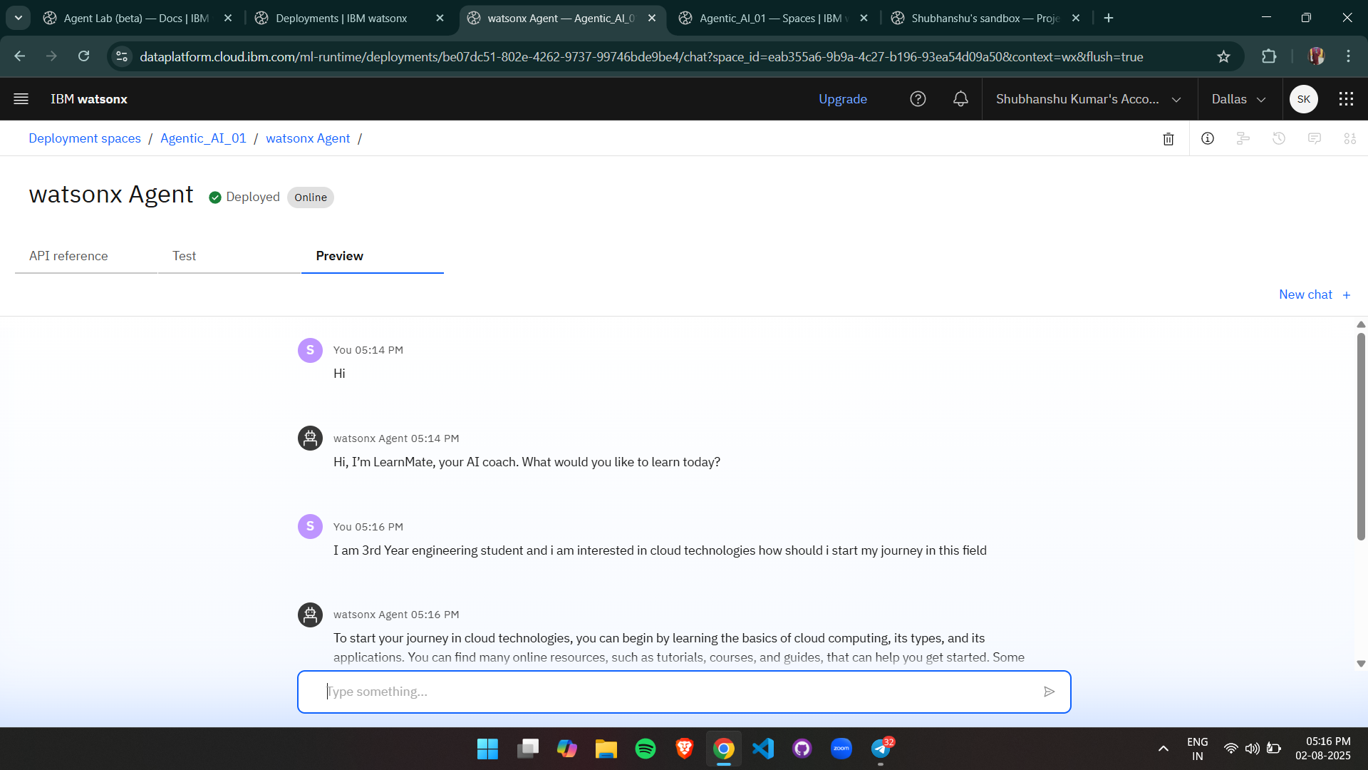
Result

Slide 8
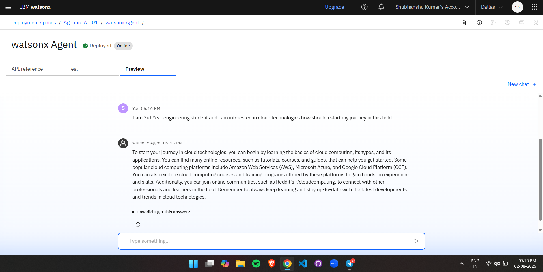
Result

Slide 9
Conclusion
LearnMate effectively tackles the challenge of personalized learning by using Agentic AI to match student interests with adaptive learning paths. It leverages LLMs, real-time tools, and user feedback to guide learners efficiently.
Key challenges included handling vague inputs and tool integration, which were addressed through prompt tuning and structured flows.
Future improvements include deeper personalization and expanded domain support. LearnMate offers a scalable solution to guide students with clarity and confidence in their learning journey.

Slide 10
Future scope
Enhanced Data Integration: Include behavioral analytics, learning pace, and third-party course platforms.
Algorithm Optimization: Use advanced ML techniques for better skill assessment and roadmap accuracy.
Scalability: Expand support for diverse domains and regional learning patterns.
Edge Deployment: Enable faster, privacy-friendly recommendations using edge computing.
Real-Time Adaptation: Improve responsiveness with continuous learning from user feedback.
Wider Deployment: Integrate with schools, coaching centers, and online learning platforms globally.

Slide 11
References
IBM Watsonx.ai Docs – Model deployment and inference on IBM Cloud. https://www.ibm.com/cloud/watsonx
IBM Research – AI for Education Exploring the role of AI in personalized learning environments https://research.ibm.com

Slide 12
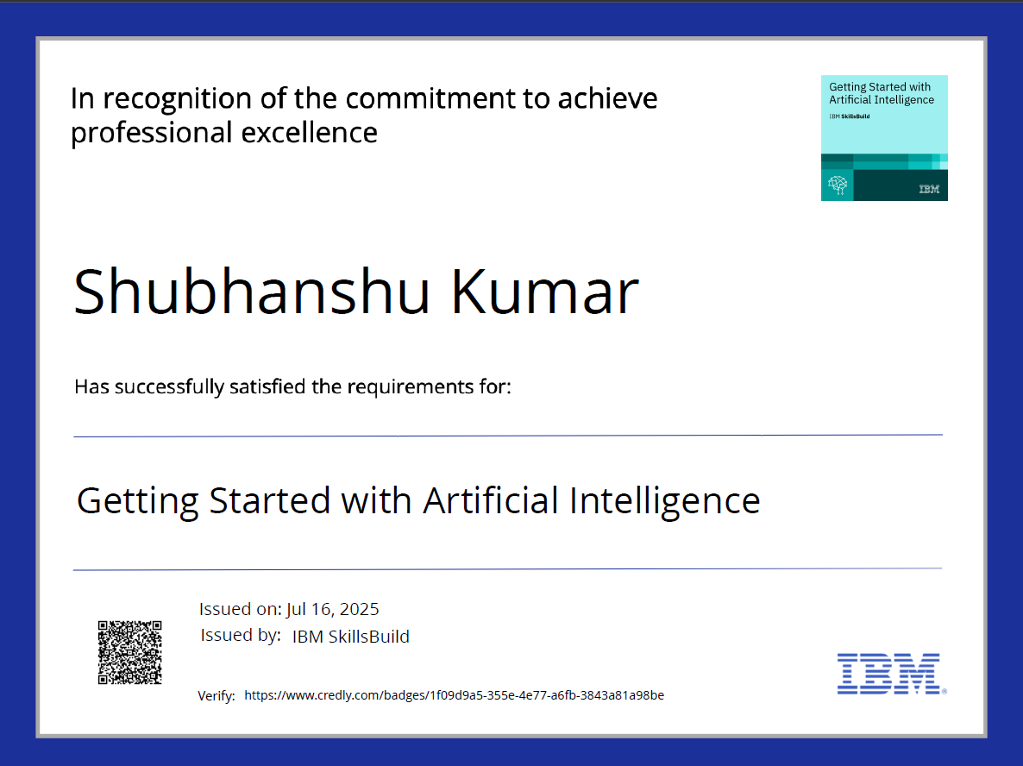
IBM Certifications

Slide 13
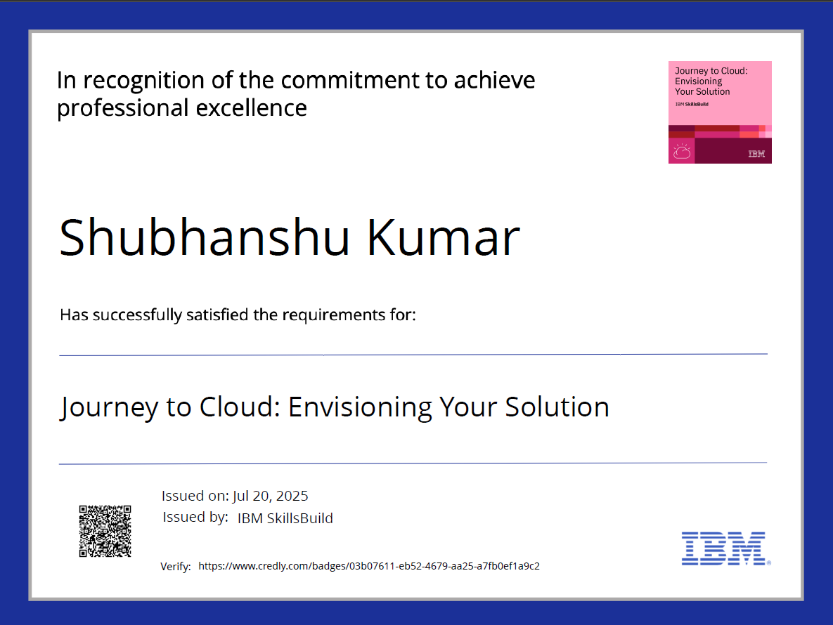
IBM Certifications

Slide 14
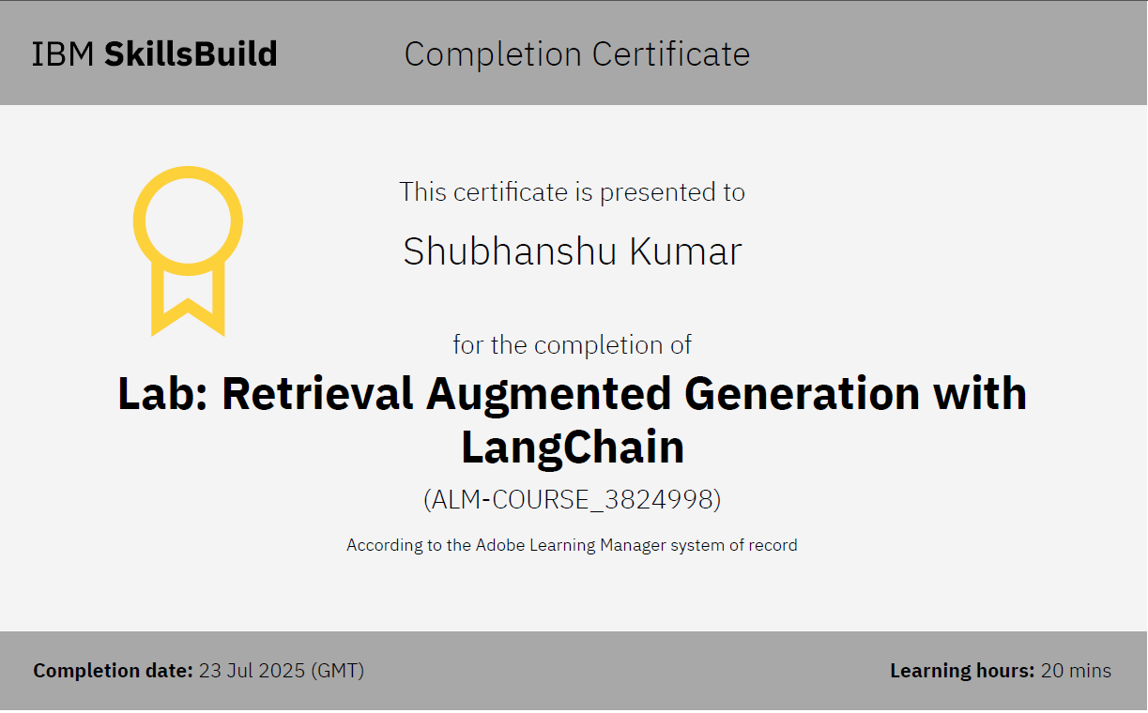
IBM Certifications

Slide 15
THANK YOU

